Slide 1

Transport Data Analysis
Presented By: Jurgen Tan

Slide 2
URLs
COE Results : https://data.gov.sg/dataset/coe-bidding-results
Driving Licence: https://data.gov.sg/dataset/driving-licence-information-qualified-driving-licence-holders
HDB Carpark https://data.gov.sg/dataset/hdb-carpark-information
Notes:
Cost Of Owning A Vehicle is it due to the increasing of license holders and if there are more vehicles on the road, is the HDB increasing the number of parking lots?

Slide 3
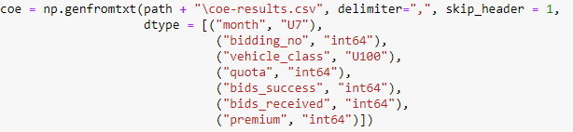
COE Results Dataset
Bidding Number : 1 (Week 1) & 2 (Week 3)
Category A: Car up to 1600CC & 97KW
Category B: Car above 1600CC or 97KW
Category C: Goods Vehicle & Bus
Category D: Motorcycle
Category E: Open

Slide 4
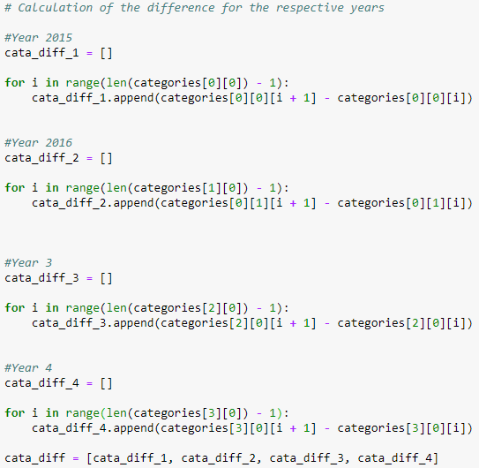
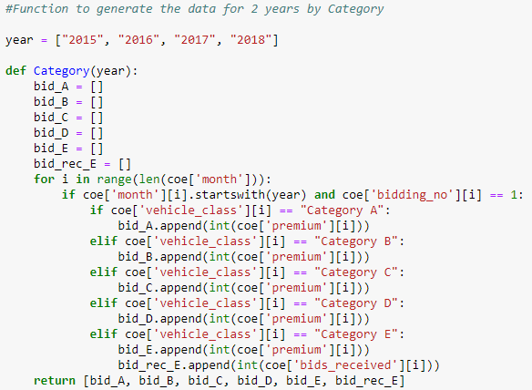
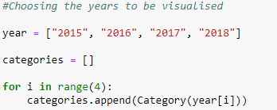
COE Results Dataset Preparation
Function to seperate the different categories
List of the different years
Calculate the difference for the month as compare to the month before

Slide 5
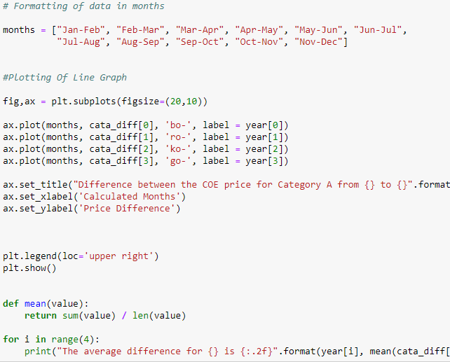
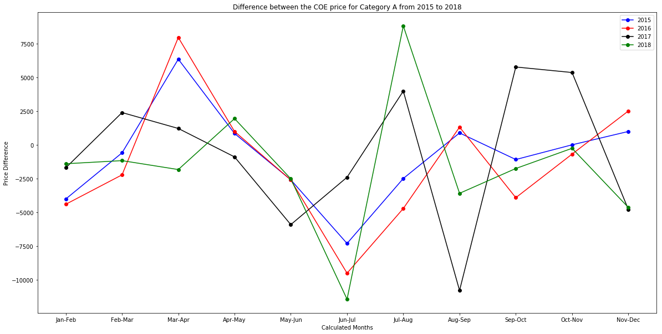

Price Difference Between The Months From 2015 to 2018 For Category A
Negative : Cheaper & Positive: More Expensive
High Volatility
May – Jul: 2015, 2016 & 2018 Plunge
Jun – Aug: 2015, 2016 & 2018 Peak
2017 was very unlike the past data
Notes:
When Is The Best Month To Buy A Car

Slide 6
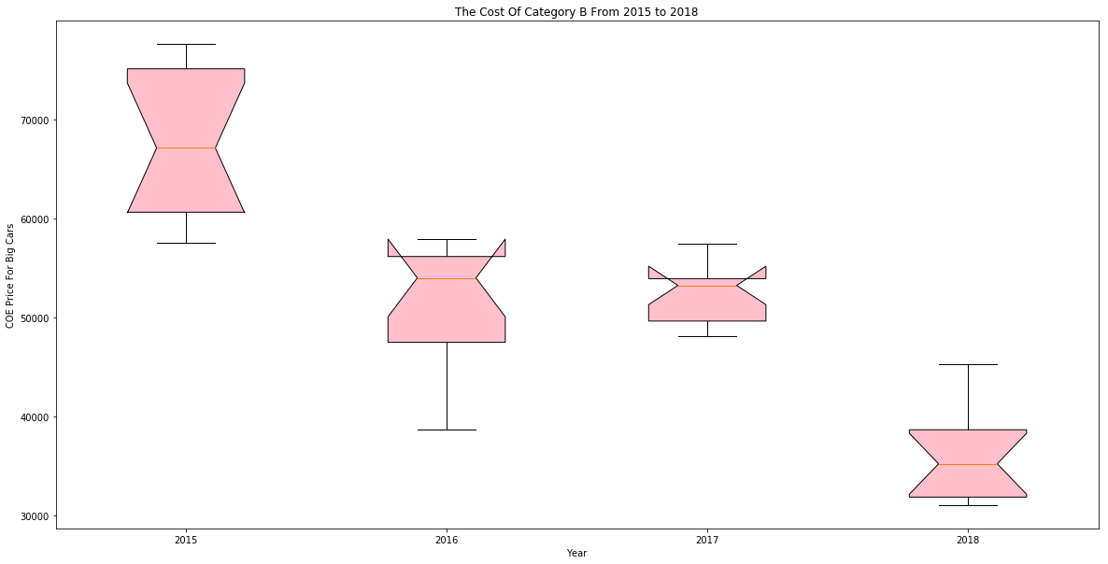
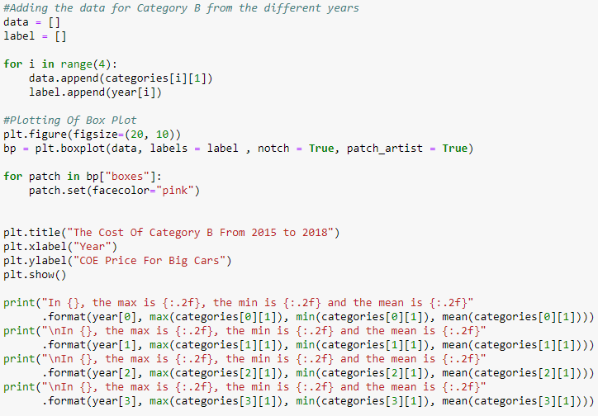
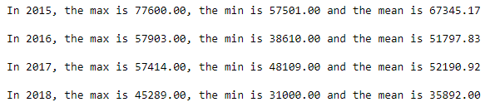
The Cost Of Category B From 2015 to 2018
2015 Min & 2016 Max is almost the same
2017 Min & 2018 Max is almost the same
CI > UQ : 95% for 2016 & 2017
Notes:
Price Range For The COE Of Larger Cars

Slide 7
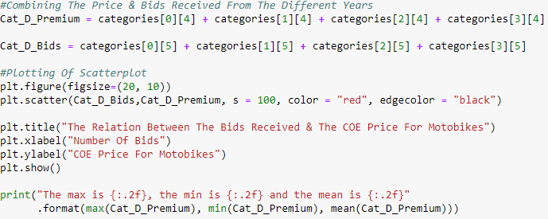
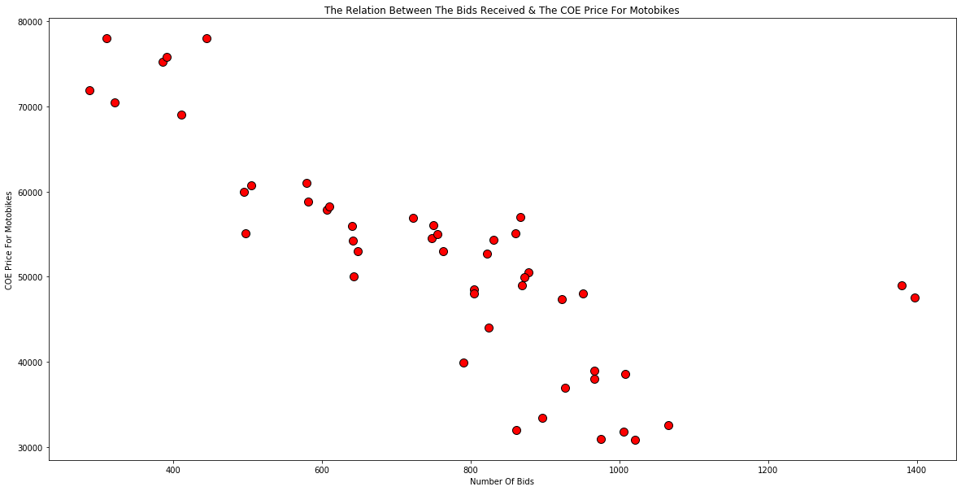
The Relation Between The Bids Received & Category D
Negative Gradient, Harsh Decline
2 Outliers
Lower Bids = Higher COE Price
Notes:
Bids Received == COE Cost?

Slide 8
Driving Licence Dataset
End Of The Year
Total Number
Overlapping Of Licenses

Slide 9
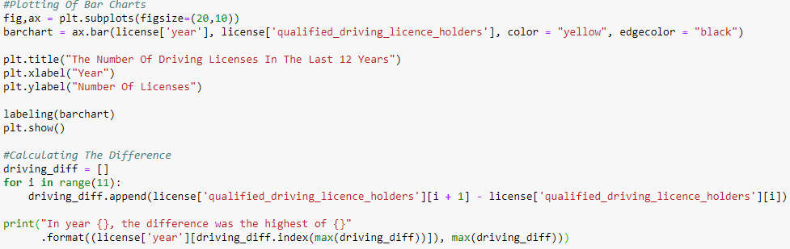
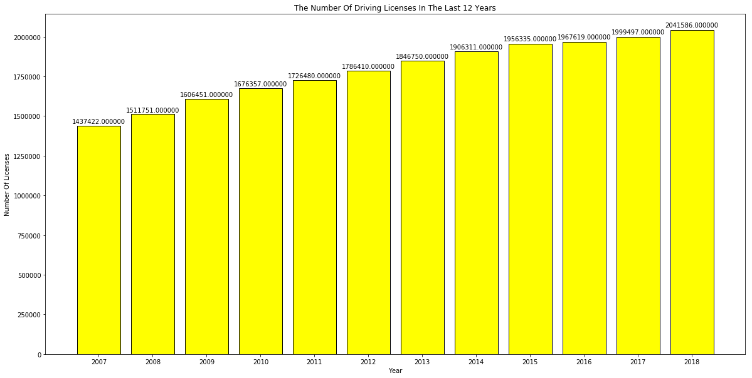
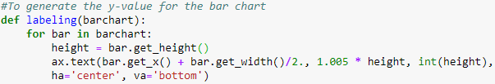
The Number Of Driving Licenses In The Last Decade
Gradual Increase Over The Years

Slide 10
HDB Capark Dataset
car_park_no | address | x_coord | y_coord | car_park_type | type_of_parking_system | short_term_parking | free_parking | night_parking | car_park_decks | gantry_height | car_park_basement
ACB | BLK 270/271 ALBERT CENTRE BASEMENT CAR PARK | 30314.7936 | 31490.4942 | BASEMENT CAR PARK | ELECTRONIC PARKING | WHOLE DAY | NO | YES | 1 | 1.8 | Y
ACM | BLK 98A ALJUNIED CRESCENT | 33758.4143 | 33695.5198 | MULTI-STOREY CAR PARK | ELECTRONIC PARKING | WHOLE DAY | SUN & PH FR 7AM-10.30PM | YES | 5 | 2.1 | N
AH1 | BLK 101 JALAN DUSUN | 29257.7203 | 34500.3599 | SURFACE CAR PARK | ELECTRONIC PARKING | WHOLE DAY | SUN & PH FR 7AM-10.30PM | YES | 0 | 0 | N
AK19 | BLOCK 253 ANG MO KIO STREET 21 | 28185.4359 | 39012.6664 | SURFACE CAR PARK | COUPON PARKING | 7AM-7PM | NO | NO | 0 | 0 | N
AK31 | BLK 302/348 ANG MO KIO ST 31 | 29482.029 | 38684.1754 | SURFACE CAR PARK | COUPON PARKING | NO | NO | NO | 0 | 0 | N
AK52 | BLOCK 513 ANG MO KIO ST 53 | 29889.3457 | 39382.8134 | SURFACE CAR PARK | COUPON PARKING | WHOLE DAY | NO | YES | 0 | 0 | N
AK6 | BLOCK 728 ANG MO KIO AVE 6 | 29283.7324 | 39647.8906 | SURFACE CAR PARK | COUPON PARKING | 7AM-10.30PM | SUN & PH FR 7AM-10.30PM | NO | 0 | 0 | N
AK83 | BLK 5022 TO 5095 ANG MO KIO INDUSTRIAL PARK 2 | 31397.2241 | 39851.6191 | SURFACE CAR PARK | COUPON PARKING | NO | NO | NO | 0 | 0 | N
AK9 | ANG MO KIO AVENUE 9 | 29674.8184 | 40616.875 | SURFACE CAR PARK | COUPON PARKING | NO | NO | NO | 0 | 0 | N

Slide 11
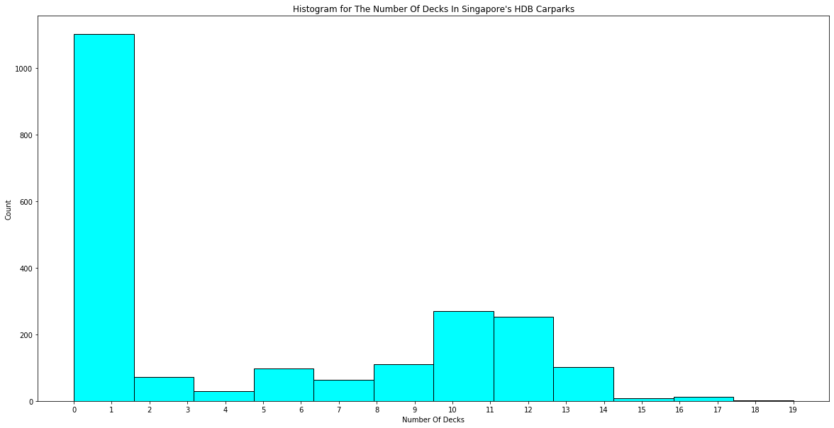
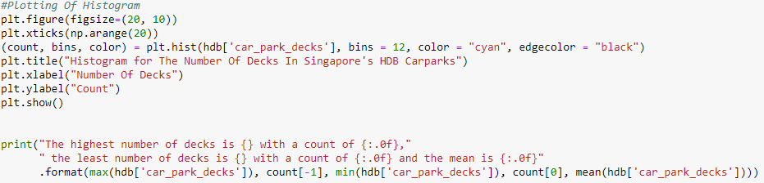
The Number Of Decks In Singapore's HDB Carparks
Most HDB Car Parks are 1 leveled
The average car park level is 5
There are only 2 HDB carparks that are 19 leveled

Slide 12
Thank You
Notes:
The increase of COE prices is not because of the number of driving licenses and that the government does have many high levelled MSCPs built in already.

